Slide 1
Yuna Lee
Self confidence
ambition
Feeling alive
success
impact
ease
motivation
priority

Slide 2
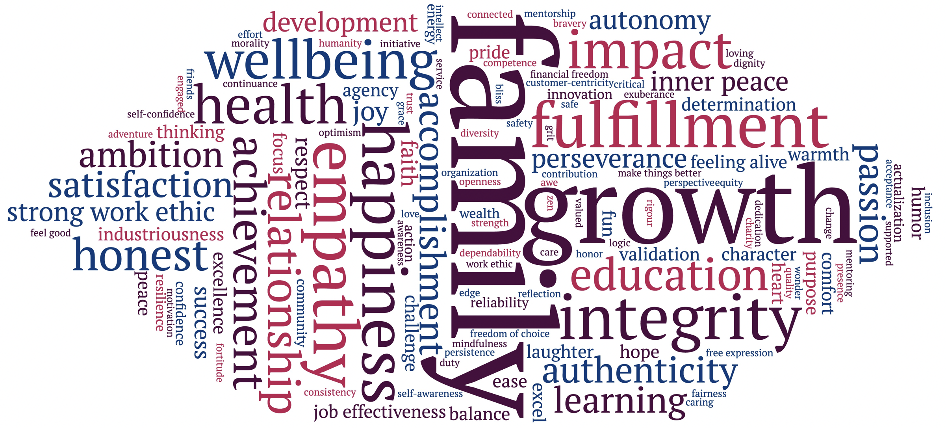

Slide 3
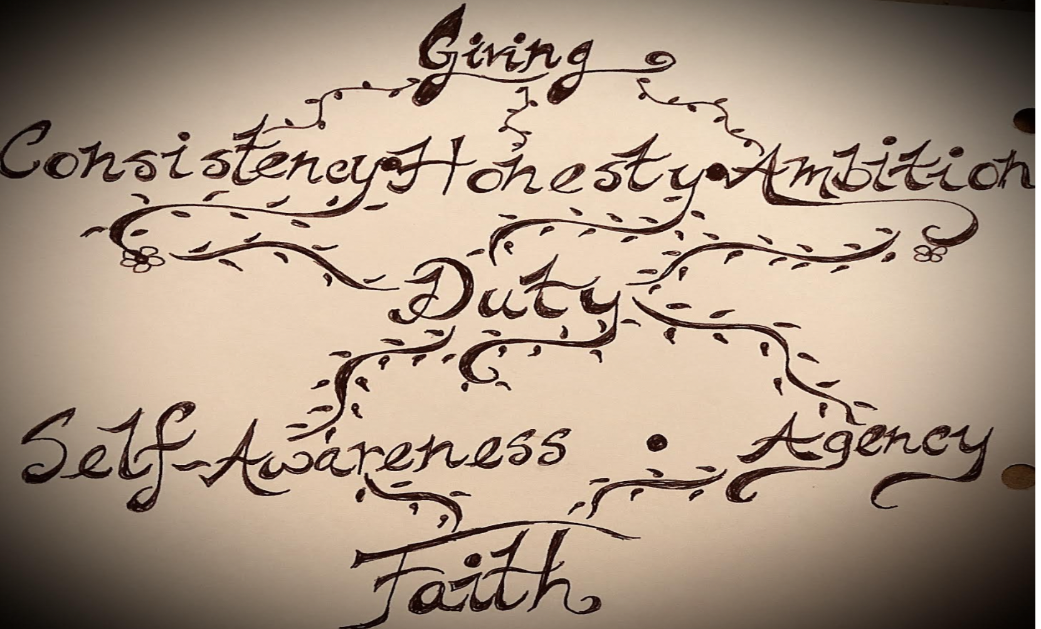
Shumaisa Rehman-Nabi

Slide 5
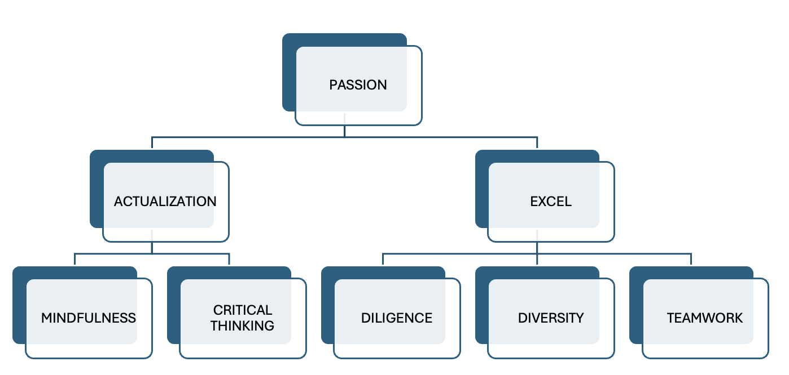
Abhinandan Kulkarni

Slide 7
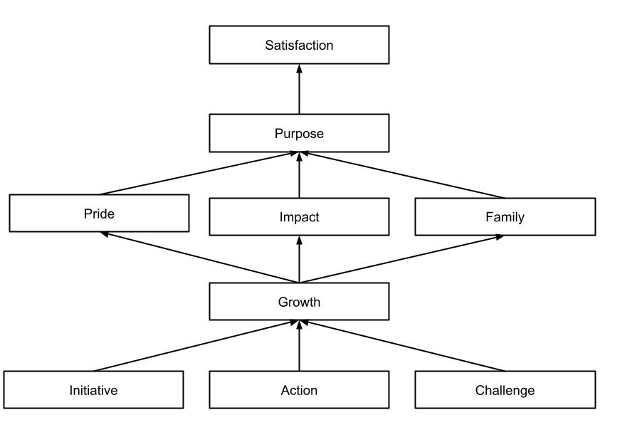
Pranav Reddy

Slide 9
Sera Pekel

Slide 11
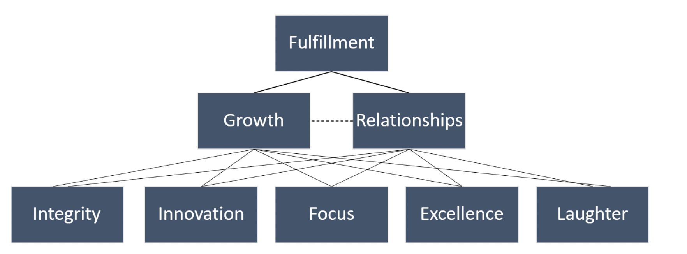
Brendan Karson

Slide 13
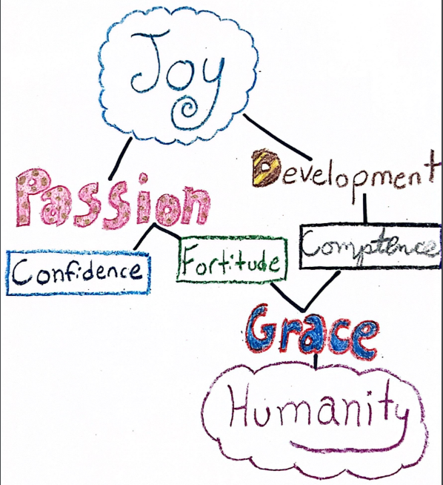
Liz Hickey

Slide 15
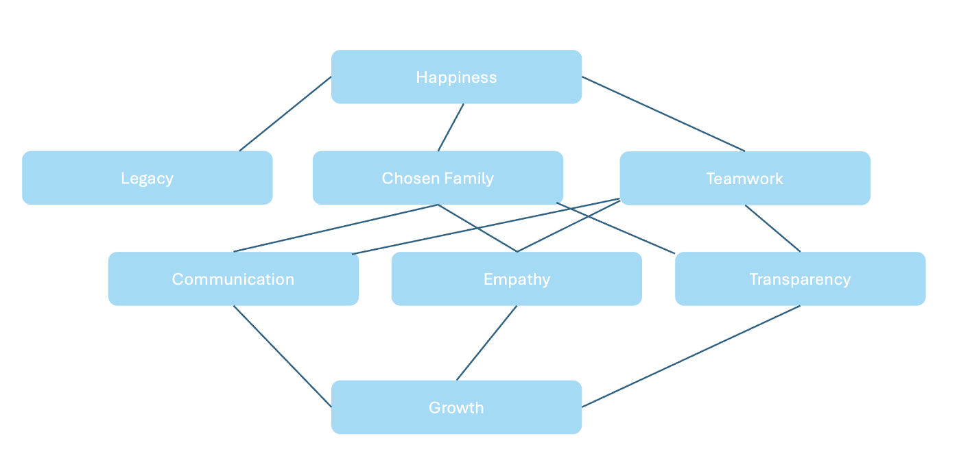
Chloe Gatta

Slide 17
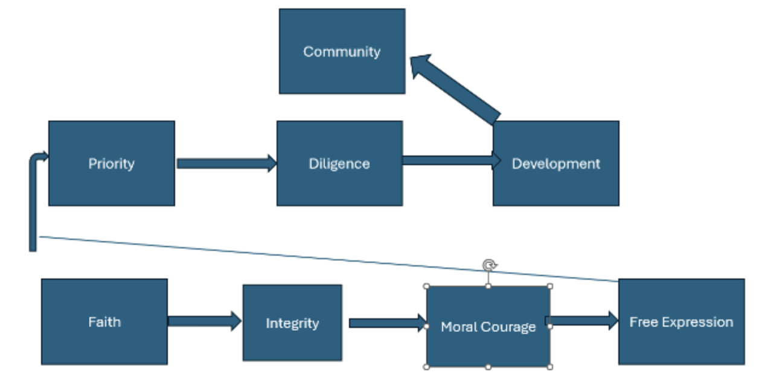
Jude Chisom Erondu

Slide 19
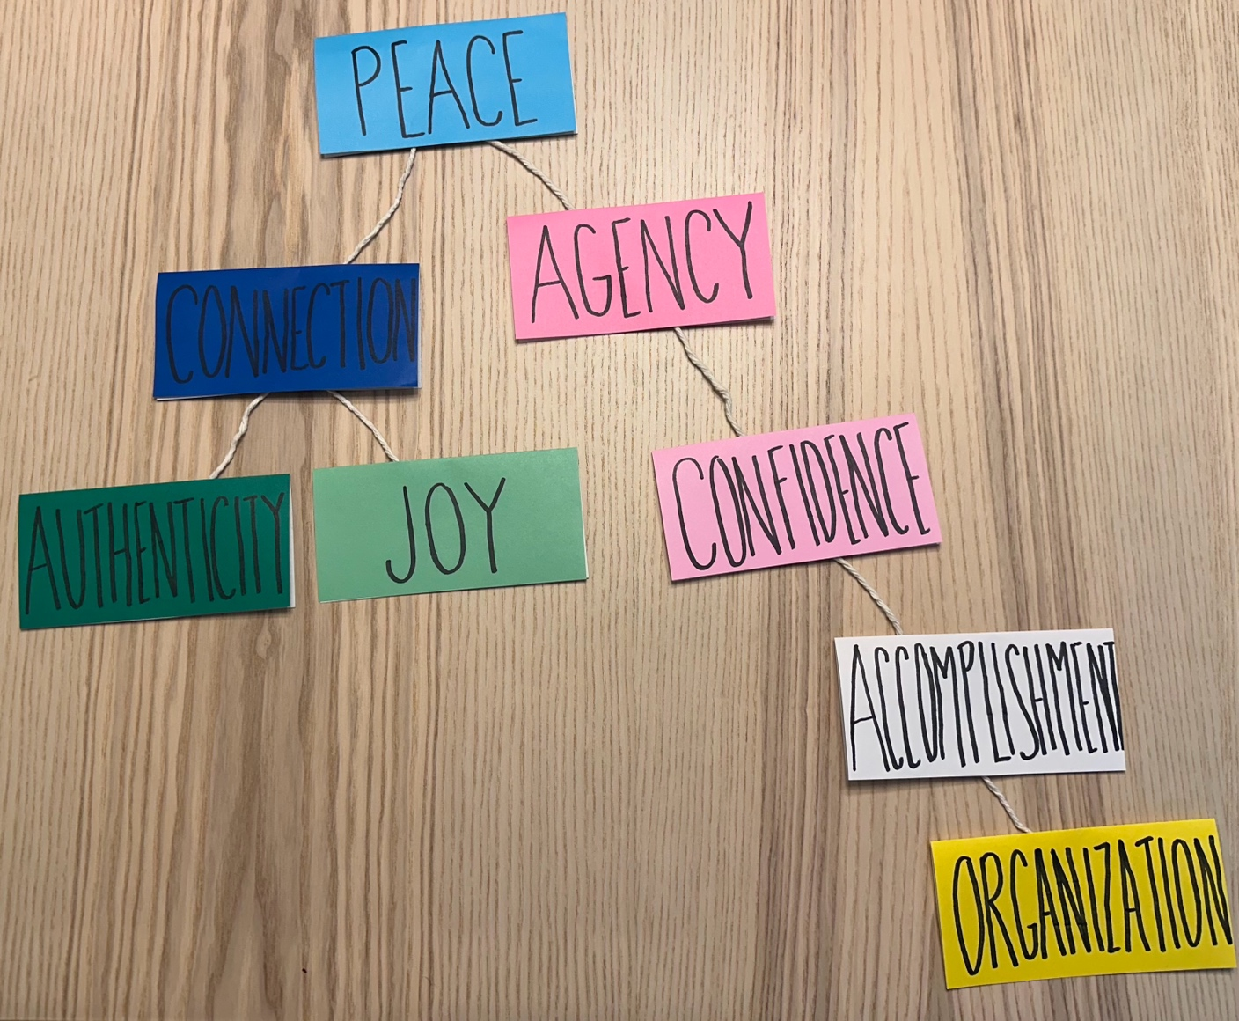
Helen Alley

Slide 21
Abby Steele

Slide 23
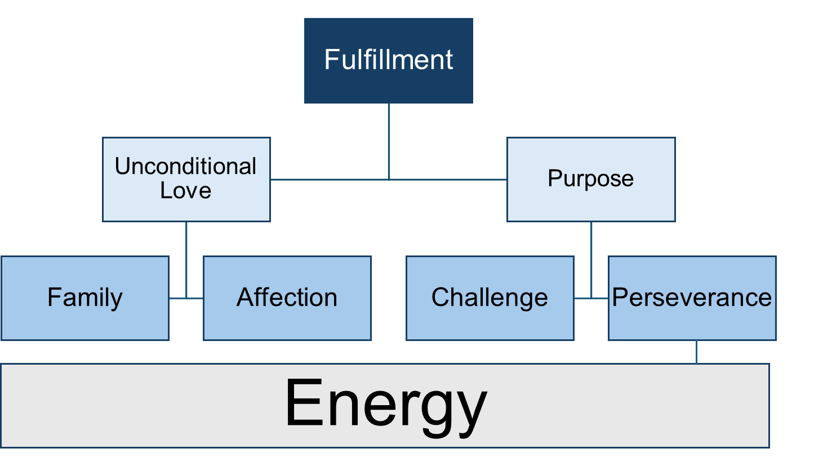
Serena Tchorbajian

Slide 25
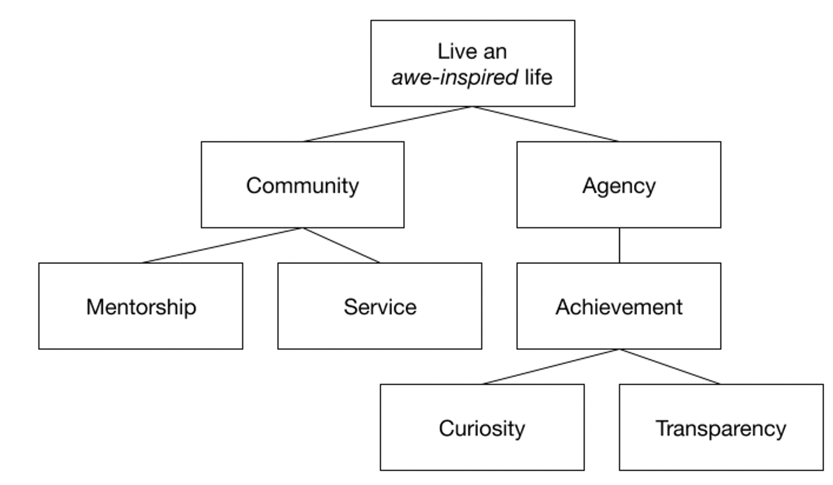
JJ Refling

Slide 27
Susan Stuehrk
Creativity
Energy
Courage
Learning
Industriousness
Discovery
Respect
Exuberance

Slide 29
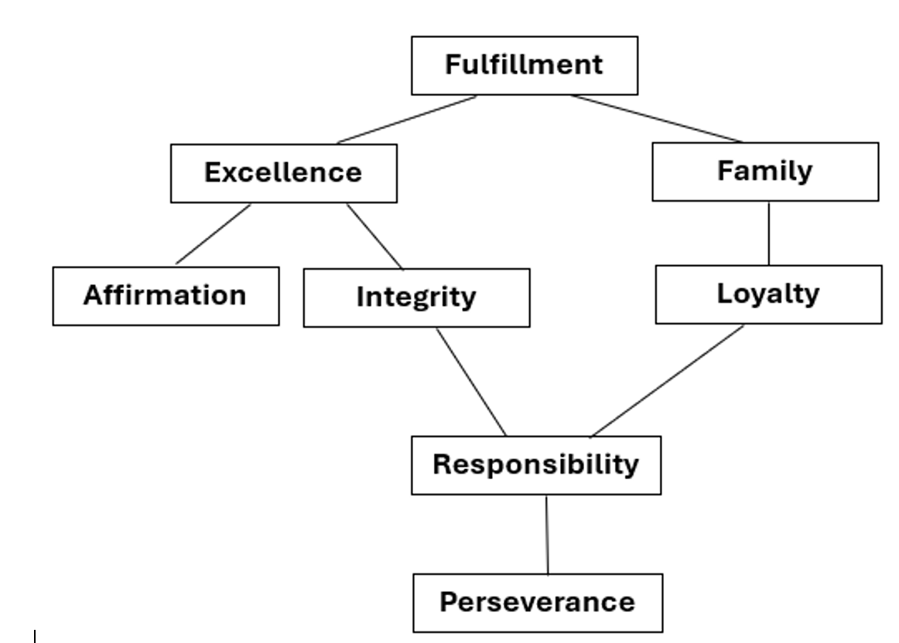
Jane Park

Slide 31
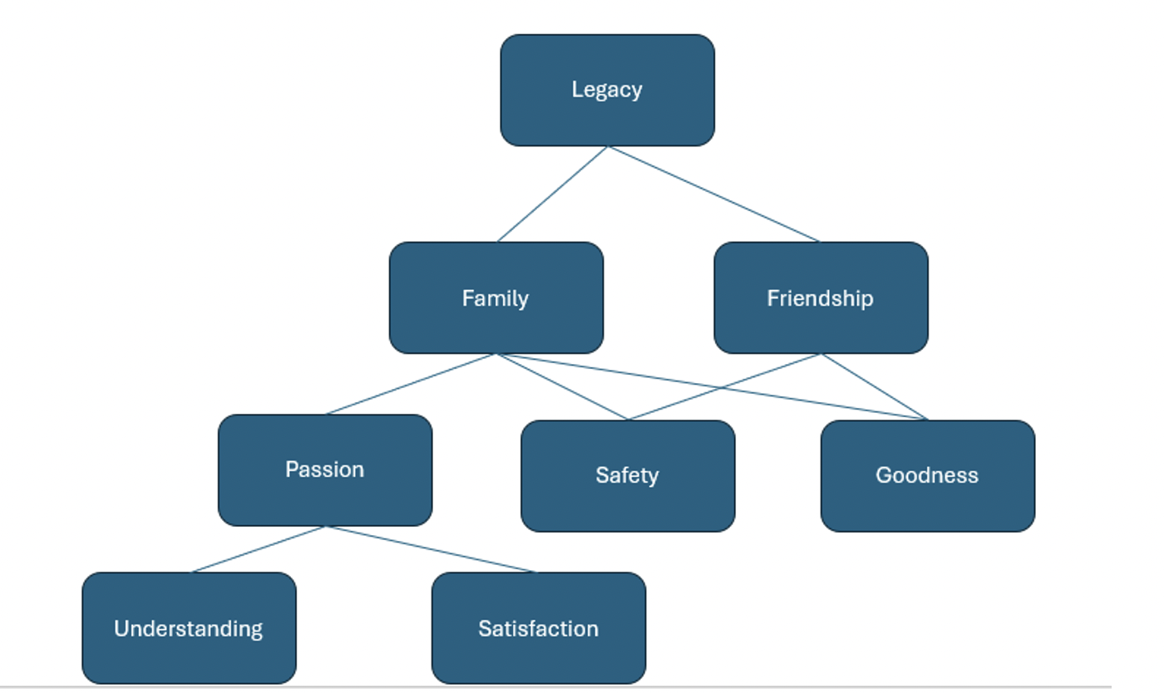
Daniel A. Torres

Slide 33
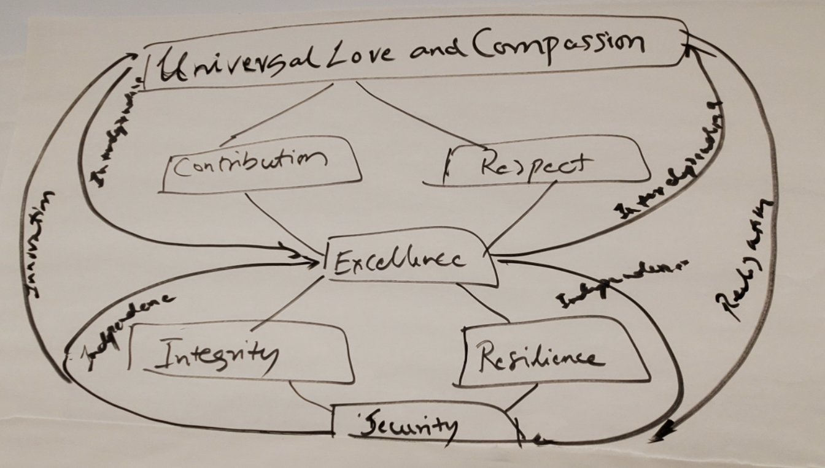
Rupesh Kumar Vuppu

Slide 35
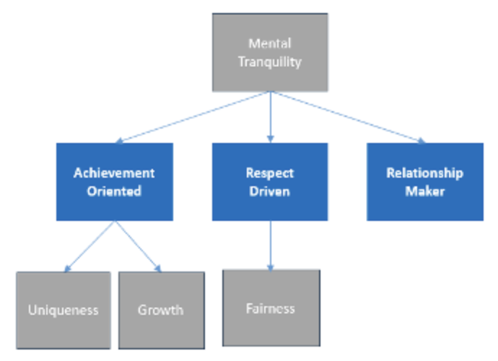
Charisma Glassman

Slide 37
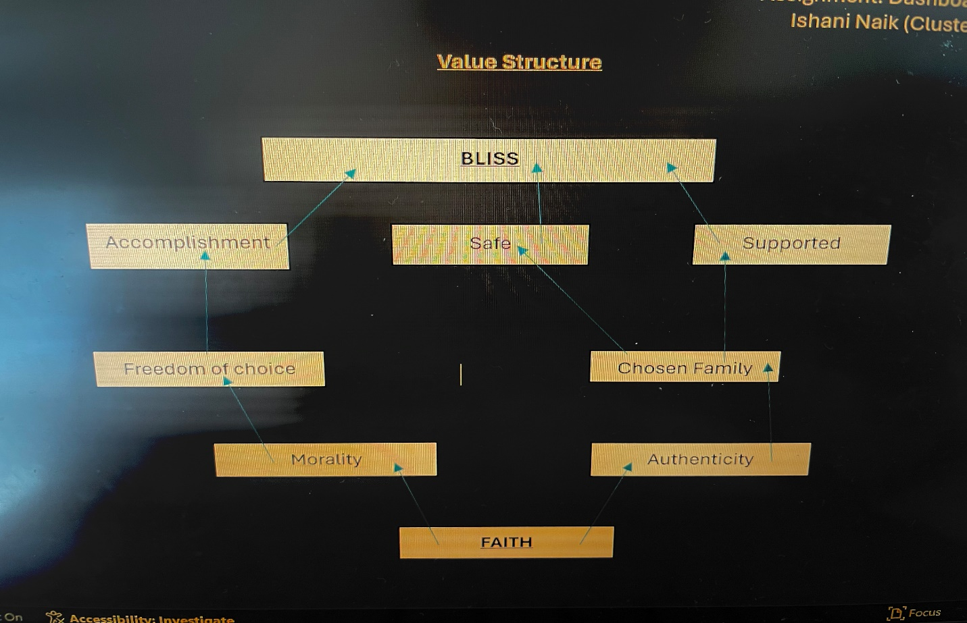
Ishani Naik

Slide 39
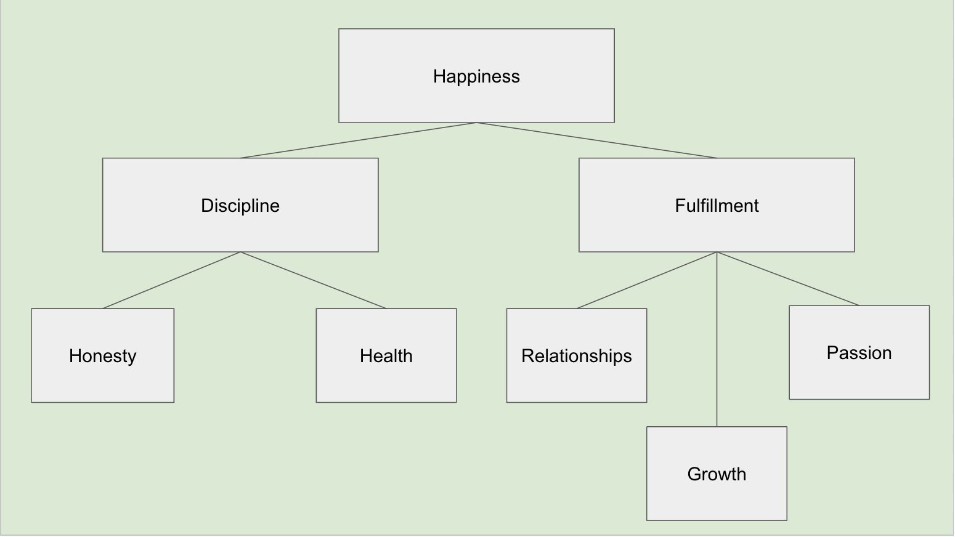
Garrett Lanigan

Slide 41
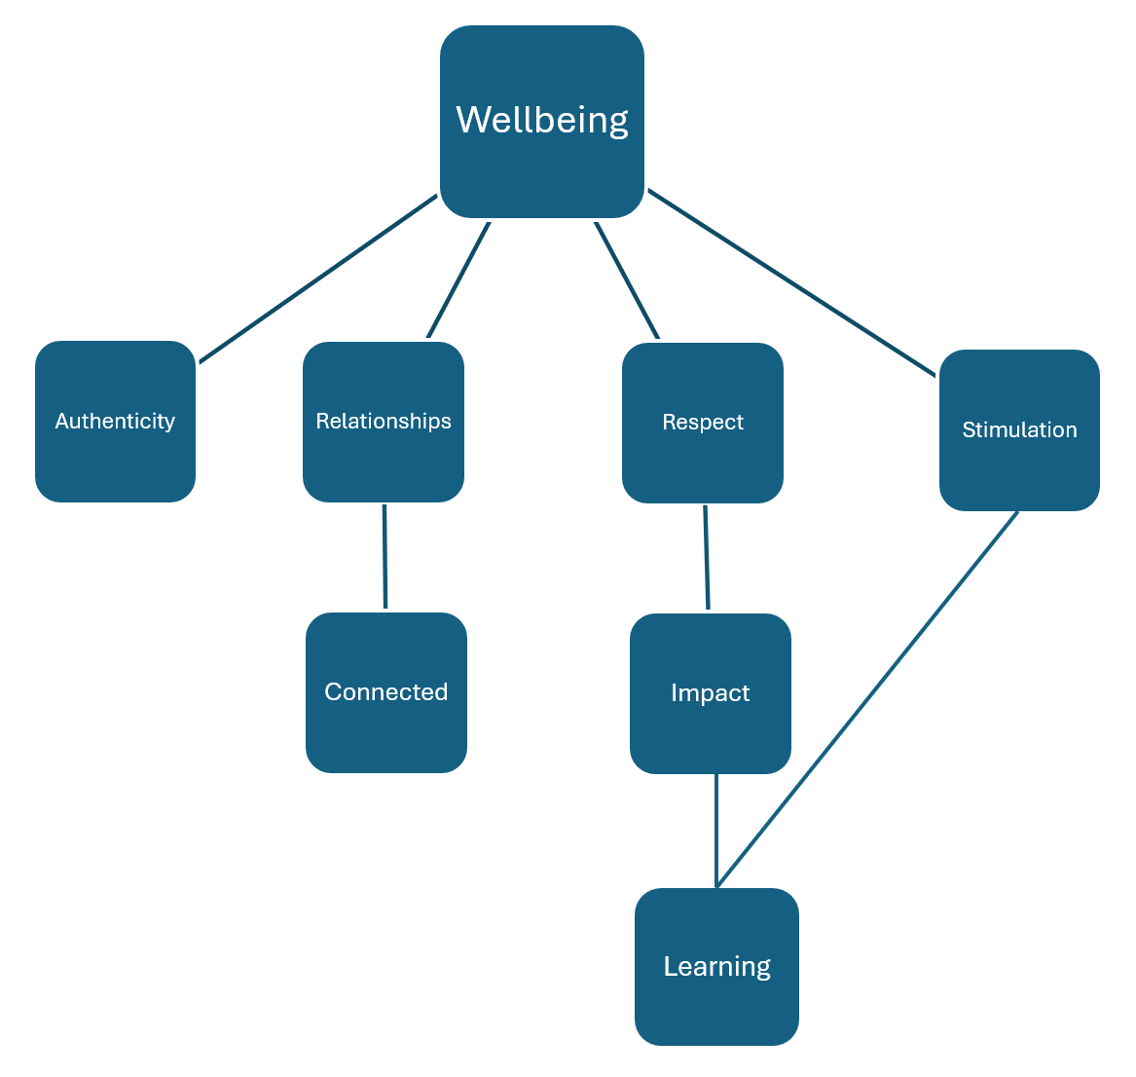
Wenying Zhao

Slide 43
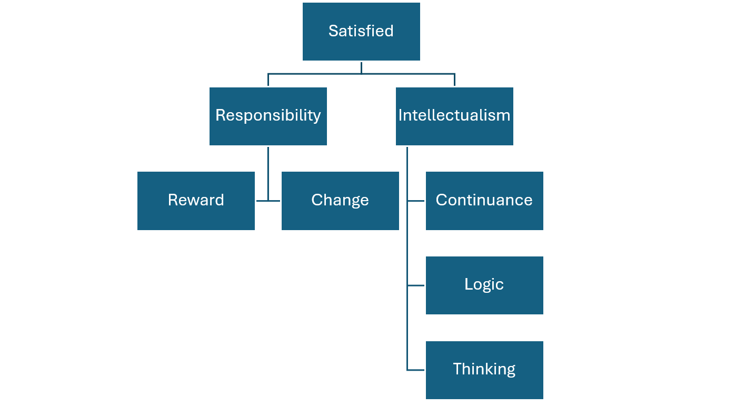
Jingpeng Zhu

Slide 45
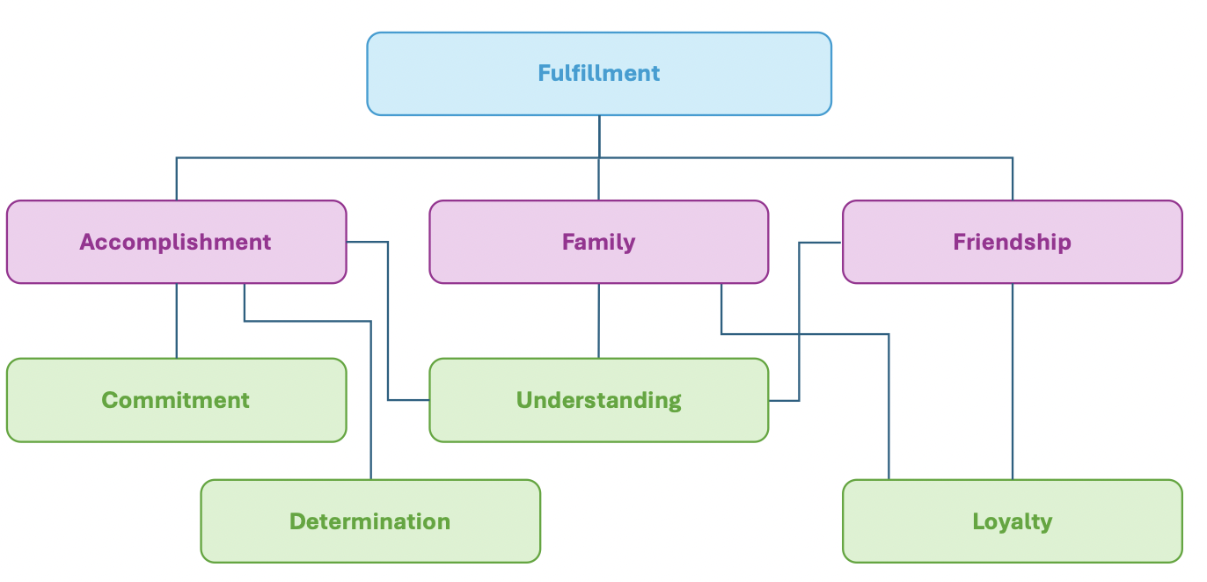
Kate Hele

Slide 47
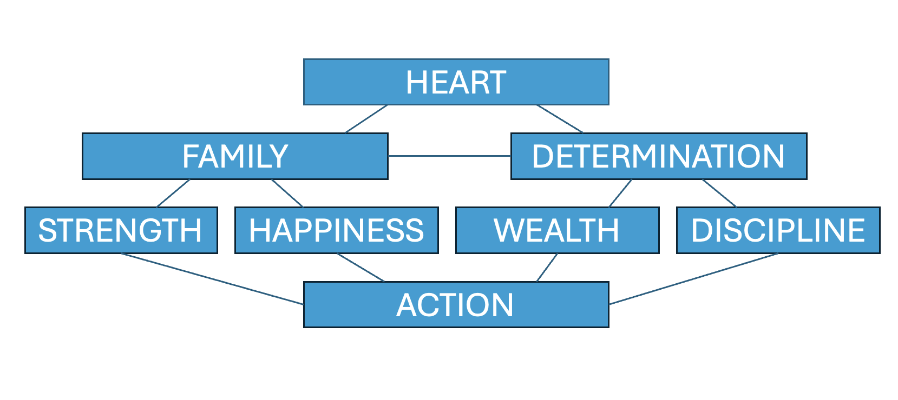
Kat Pavlovic

Slide 49
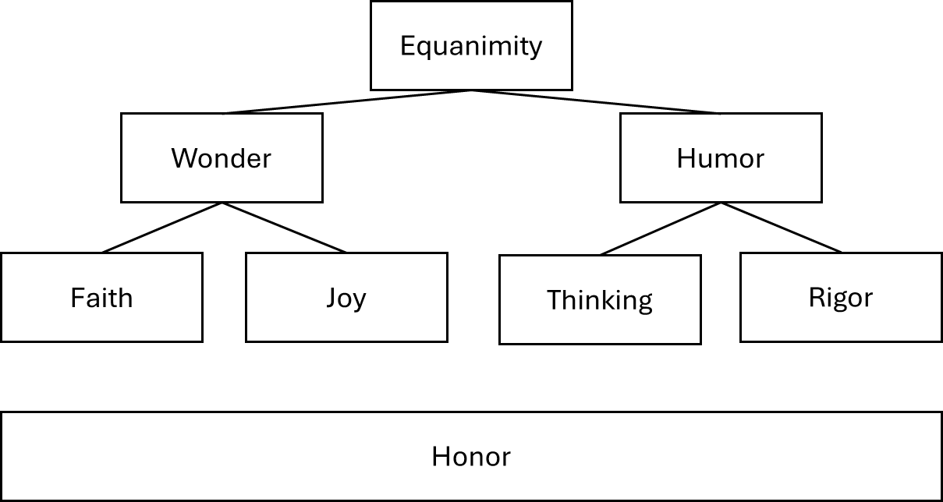
Matthew Freeze

Slide 51
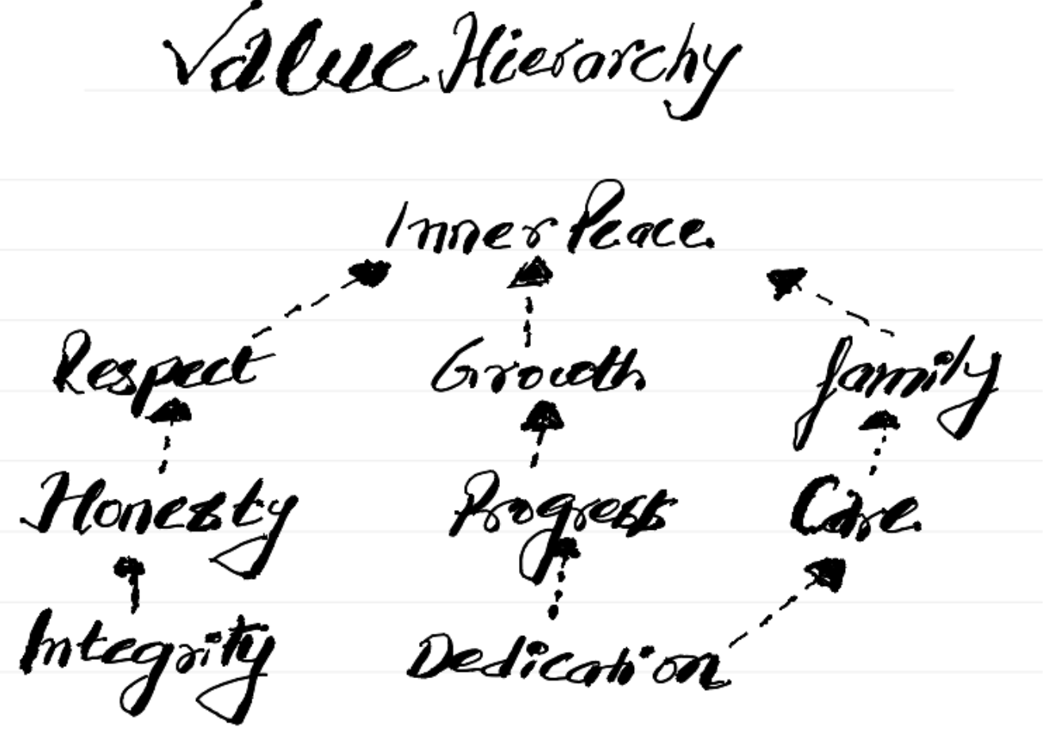
Karan Sharma

Slide 53
Shay Gao

Slide 55
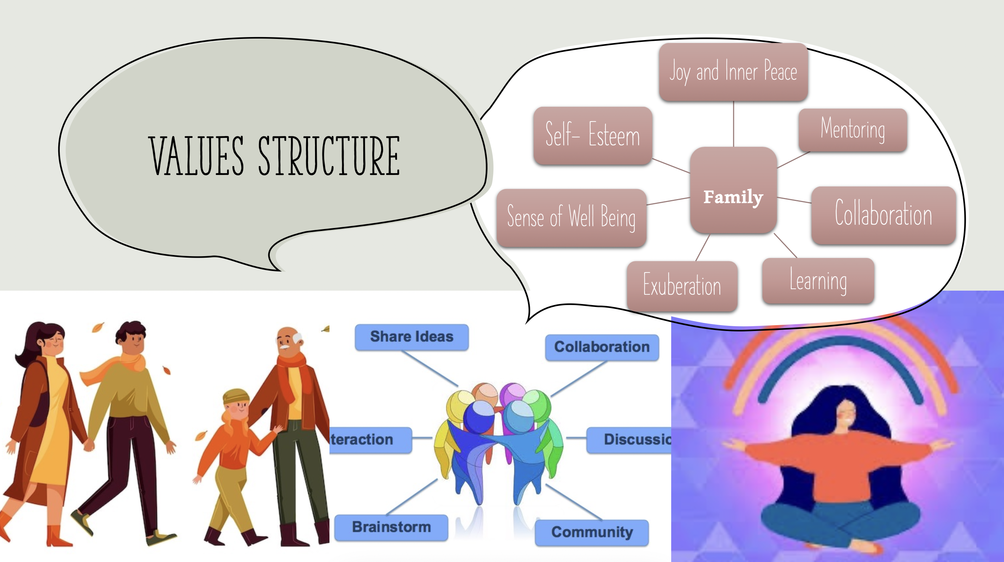
Gauri Bansal
Gauri BansalGauri BansalGauri Bansal

Slide 57
Chris Archer
Sense of Wellbeing
Accomplishment
Family
Character
Hard Work
Patience
Reliability
Empathy

Slide 59
Nagraj Bhat
Satisfaction
Make Things Better
Balance Family/Worklife
Fairness
Honesty
Caring
Strong Work Ethic
Openness

Slide 61
Pierre Bonneau
Pride
Admiration
Confidence
Excel
Stimulation
Logic
Strong Work Ethics
Laughter

Slide 63
Nikki Breeland
Stability
Affirmation
Admiration
Achievement
Edge
Congeniality
Education
Industriousness

Slide 65
Eduardo Buendia
Fulfilment
Growth
Family
Action
Trust
Heart
Effort
Respect

Slide 67
Michael Carballada
Satisfaction
Family
Progress
Ambition
Resistance
Education
Awareness
Honesty

Slide 69
Jack Dubas
Balance
Purpose
Relationship
Health
Fulfillment
Loyalty
Growth
Feeling Active

Slide 71
Bryan Salazar
Peace
Balance/ Family/ Work/ Life
Happiness
Accomplishment
Gratitude
Giving
Health
Perseverance

Slide 73
Tony Kissack
Joy
Family
Warmth
Optimism
Valued
Integrity
Reliability
Innovation

Slide 75
Paarth Taneja
Fulfillment
Significance
Achievement
Community
Growth
Well Being
Helping Others
Empathy

Slide 77
Bruno Franca
Success
Growth
freedom
Family
accomplishment
balance
discipline
Energy

Slide 79
Lucas Zheng
Equity
Health
Empathy
Quality
Continuance
Collegiality
Challenge
Hope

Slide 81
Thao Ly Nguyen
Happiness
Family
Growth
Sense of Humor
Empathy
Resiliency
Warmth
Dependability

Slide 83
Aaron Nunez
Personal Fulfillment
Achievement
Knowledge
Validation
Perseverance
Passion
Warmth

Slide 85
Christopher Morris
Gratitude
Inclusion
Spontaneity
Impact
Family
Experimentation
Grit
Faith

Slide 87
Busisiwe Mombaur
Agency
Financial Security
Authenticity
Significance
Success
Family
Affection
Communication

Slide 89
Max Quinn
Happiness
Growth
Empathy
Impact
Well-being
Learning
Challenge
Innovation

Slide 91
Curtis Rose
Happiness
Family
Honesty
Job Effectiveness
Fun
Organized
Humor
Engaged

Slide 93
Mark Thompson
Hope
Education
Challenge
Strong Work Ethics
Ambition
Make a Difference
Success
Responsibilities

